Slide 1



www.coremedia.com

Slide 2

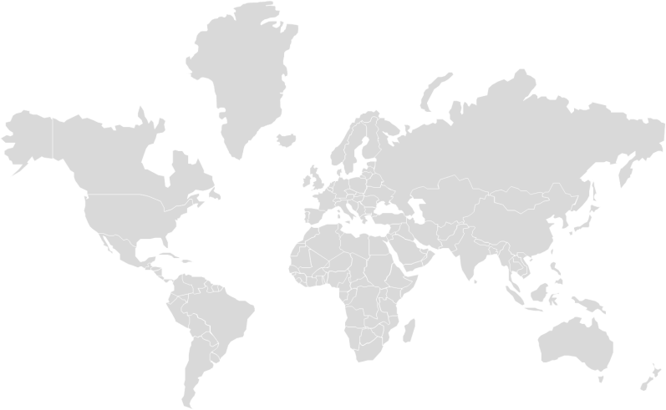

CoreMedia
Web Content Management
150 employees
4 offices worldwide
500 partner consultants
17 years of profitable growth
Privately held corporation

Slide 3



























CoreMedia Customers Worldwide

Slide 4






















CoreMedia Partners

Slide 5


Nokia: CoreMedia drives corporate change from Telco to Internet business
Partner: IBM
Leading provider of mobile and connectivity technologies
Replaced Vignette with CoreMedia CMS
Beat SDL Tridion
Global Web presence for 68 countries with 44 languages

Slide 6

Internet Broadcasting: CoreMedia offers scalable WCM to TV stations
Provider of online media solutions for local U.S. TV stations
Replaced a home-grown system with CoreMedia CMS
      Beat Canvas CMS
      Cloud-based WCM for media outlets offering delivery of contextualized content
Partner: PerfectSense

Slide 7
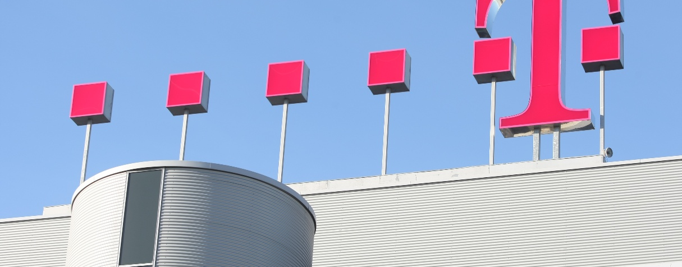
DTAG: A highly personal and global approach to Web Content Management
Deutsche Telekom
Europe’s largest online portal with 200 million customers
Intranet for 240K+ employees
Up to 4.6 billion PIs per month
50 portals on one CMS
Highly personalized content for site visitors
Multi-lingual capabilities
Integration of over 100 third-party systems
E-business processes for partners and dealers

Slide 8

Content Management System consists of 70-80% Java

Slide 9
Advantages in CoreMedia AG
Fun at work and attractive payment are very important . But that's not all we can offer you:
Beginner’s Day
Where is the printer? Where can you eat lunch? And where are sitting the colleagues? Every beginning is difficult. We'll help you on the first day and tell you everything you need to know about products, processes, organization and technical infrastructure.
Working Atmosphere
You work in bright, spacious offices . Open transitions and lots of glass create a lot of space for communication.
What's new in the company? You will find out it at "core Vadis". Core Vadis is an information event management for all interested employees.
Career model
More responsibility leads to higher pay and more exciting tasks. New positions are advertised internally only. Our career paths plan shows you possible developments transparent and thoughtful on - or you walk into your own individual career path. You have the chance to systematically develop your career further.
Location
Our Hamburg office is conveniently located between the city, harbor and St. Pauli. Directly opposite the rings Michel, Hamburg's most famous church. Just around the corner, the cozy Großneumarkt, wait many small restaurants with their lunch on your visit. The metro station Rödingsmarkt and S-Bahn station Stadthausbrücke you reach in a few minutes. Joyful and nightlife lure the colorful lights of the Reeperbahn.
Mobility
You will receive a free ticket for the Hamburg Transport Association.
Sabbatical
Do you need some distance? CoreMedia offers you a sabbatical scheme for a longer time off work.

Slide 10
Sabbatical
Do you need some distance? CoreMedia offers you a sabbatical scheme for a longer time off work.
Company values
Our three core values ​​we consider as a self-commitment. We have formulated it as "standards of cooperation" in our mission statement: "For the customer to be the best," we see the highest value of our working atmosphere. “ To be ready for each other" shapes our organizational culture. And “To be fair" is the maxim of our culture of debate.
Bonus
We want to continue to grow, that s why we need more staff. Obtain us capable candidates from your personal environment. Which positions are available currently, you learn from the internal job postings. We reward each successful placement with a generous bonus.
Further training
Knowledge is our greatest asset. We attach value to a regular training. Together with your supervisor and coach you put your fixed individual training program to both the professional as well as personal learning programs as well as external and internal training in our own training center.
Cooperation
Relationships are as important as technical issues. This must be practiced. With the cooperation, CoreMedia prescribed a sustainable learning program. It includes a number of methods and tools that arr mediated through workshops and training in their daily work.

Slide 11
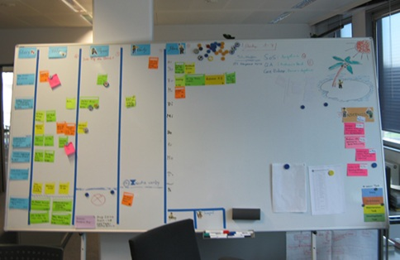
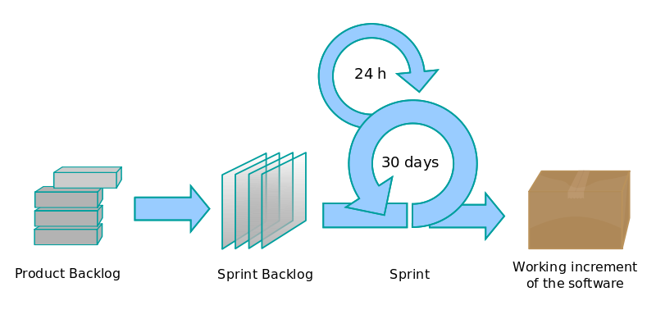
We work mit Scrum
Scrum is an iterative and incremental Agile software development framework for managing software projects and product or application development.
The Scrum process
A Scrum task board

Slide 12
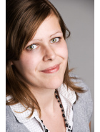
Jobs and Practice
We are constantly looking for:
• Software Engineer in Customer Projects (m/ f)
• Software Engineer (m/ f)
We also offer students the opportunity to work as an intern for us or to complete an internship and write theses.
These and other current vacancies can be found on our website. There (and on Facebook) and there is also additional information, a movie about our company as well as images and snapshots.
www.coremedia.com/karriere
www.facebook.com/coremedia
You want to be part of the team?
Then send us your application (in English) including a motivation letter, CV and references.
Verena Traub
Recruiting Manager
Ludwig-Erhard-Street 18
20459 Hamburg
Tel: 040.325587.602
Fax 040.325587.999
verena.traub@coremedia.com
Ukrainian partner:
Tetiana.kostiuk@coremedia.com

Slide 13
Thank you for your attention
If you have guestions, connect me tetiana.kostiuk@coremedia.com

